Slide 1


Web Development
Week 4
Part 1: Responsive Design and Bootstrap
Abertay
abertay.ac.uk

Slide 2
Differences in Devices
Difference between PCs, Tablets, and Smartphones:
Device layout
Screen size
User controls

Slide 3
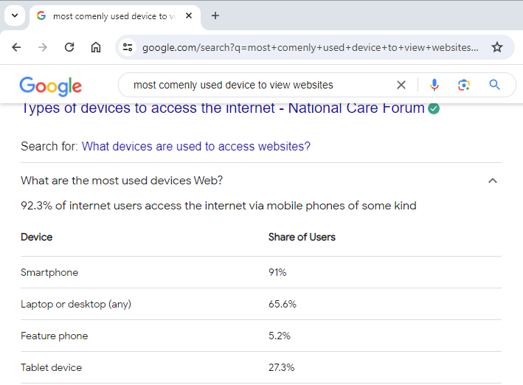
What Devices are People Using?

Slide 4

Responsive Design
A responsive web page adjust itself depending on the device or window size
Offers the most device appropriate user input methods
Overall, it should provide a seamless and intuitive experience across all devices

Slide 5
Bootstrap
Abertay
abertay.ac.uk

Slide 6
What Can Bootstrap Do?
Bootstrap makes it easy to create responsive web pages
Bootstrap includes HTML and CSS based templates for:
Typography
Forms
Buttons
Tables
Navigation
Modals
Image carousels
Optional JavaScript plugins
And much more

Slide 7
Bootstrap 5
Released 2021, Bootstrap 5 is the newest version of Bootstrap
Bootstrap 5 supports the latest, stable releases of all major browsers and platforms.
However, Internet Explorer 11 and down is not supported.
Bootstrap 5 has switched to vanilla JavaScript
While previous visions use jQuery
https://www.w3schools.com/bootstrap5/index.php

Slide 8
Bootstrap includes
Include Bootstrap 5 in the Head section of your HTML to use it
<!-- Latest compiled and minified CSS --> <link href="https://cdn.jsdelivr.net/npm/bootstrap@5.3.3/dist/css/bootstrap.min.css" rel="stylesheet"> <!-- Latest compiled JavaScript --> <script src="https://cdn.jsdelivr.net/npm/bootstrap@5.3.3/dist/js/bootstrap.bundle.min.js"></script>
Or you can download and host Bootstrap 5 yourself https://getbootstrap.com/

Slide 9
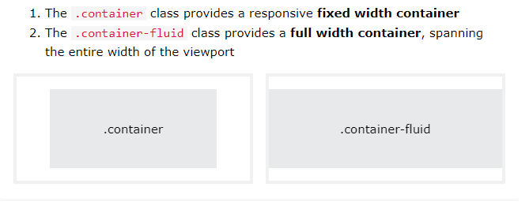
Bootstrap The Basics
Bootstrap requires a containing element to wrap site contents. Containers are used to pad the content inside of them, and there are two container classes available:
https://www.w3schools.com/bootstrap5/bootstrap_containers.php

Slide 10
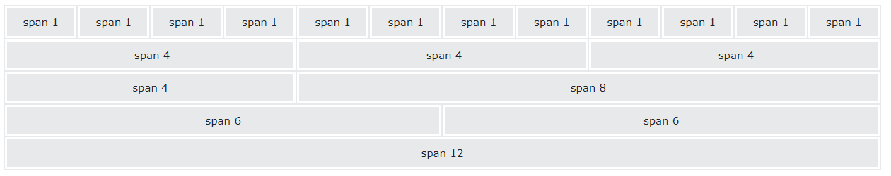
Bootstraps Grid System
The grid system a big part of how bootstrap makes responsive design easy
The flexbox and allows content to be displayed with a maximum of 12 columns across a page
The grid system allows the columns to re-arrange automatically depending on the screen size and your settings

Slide 11
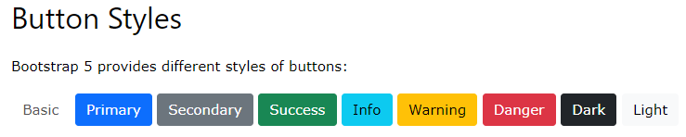
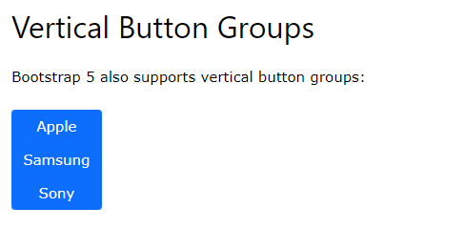
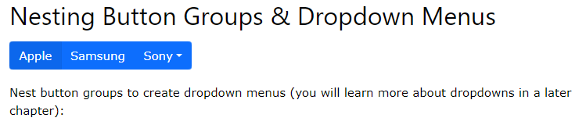
Bootstraps Buttons
https://www.w3schools.com/bootstrap5/bootstrap_buttons.php
https://www.w3schools.com/bootstrap5/bootstrap_button_groups.php

Slide 12
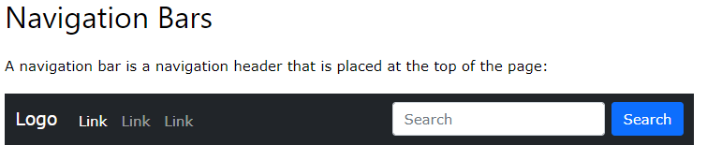
Bootstraps Website Navigation
https://www.w3schools.com/bootstrap5/bootstrap_navbar.php

Slide 13
So much more….
https://www.w3schools.com/bootstrap5/index.php

